Slide 1



Data Warehousing Fundamentals
Now you know what is operational data
and the need of Operational data. But when the business needs to make decisions or strategies it needs informational system which is nothing but our Data Warehouse. Here you learn what is a data warehouse and how we design it.
Welcome to Data Warehousing Fundamentals!!!!

Slide 2







Content Overview
Data Warehousing fundamentals session provides knowledge and understanding of concepts related to Data Warehouse like DW Definition, Features, Data, Business Benefits, Application Areas, Architecture, Implementation and Differences from Operational Systems.
Data Warehouse Definition
Features & Data of Data Warehouse
Diff From Operational Systems
Data Warehouse Fundamentals
Business Benefits
Application Areas
Architecture and Implementation

Slide 3
Objectives
Through this chapter you will be able to understand:
What is a Data Warehouse?
What is the need for a Data Warehouse?
What is the structure of a Data Warehouse?
How is a Data Warehouse different from an operational system?

Slide 4

Need for Data Warehouse
Let me explain why we need a Data Warehouse?
Operational data helps the organization to meet the operational and
tactical requirements for data.
While the Data Warehouse data helps the organization to meet
strategic requirements for information.
The strategic data helps the business with the following needs:
• Understand Business Issues
• Analyze Trends and Relationships
• Analyze Problems
• Discover Business Opportunities
• Plan for the Future

Slide 5
Data Warehouse Fundamentals
What is a Data Warehouse?
The Data Warehouse is:
Subject oriented
Integrated
Time variant
Non-volatile
collection of data in support of management decision processes.
A Data Warehouse is a relational database that is designed for query and analysis.
It usually contains historical data derived from transaction data and other sources.

Slide 6
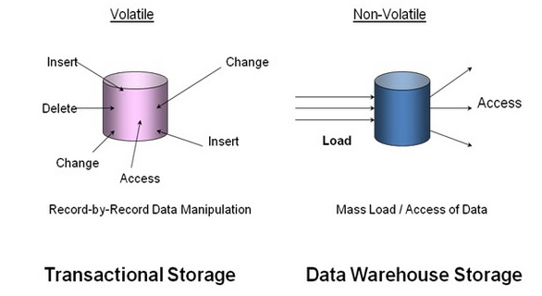
Transactional vs. Data Warehouse Storage
The way of storage of data in operational and Data Warehouse Systems

Slide 7
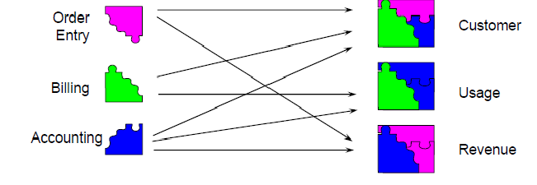
Differences from Operational Systems
Operational Systems Data Warehouse
Operational data is organized by specific processes or tasks
and is maintained by separate systems.
Warehoused data is organized by subject area and is populated from many operational systems.

Slide 8
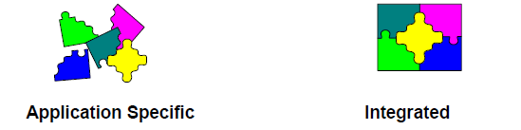
Differences from Operational Systems (Contd.)
Operational Systems Data Warehouse
• Applications and their
databases were designed
and built separately.
• Evolved over long periods
of time.
• Integrated from the start.
• Designed (or “Architected”) at
one time, implemented
iteratively over short periods
of time.

Slide 9
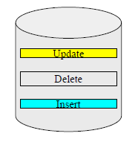
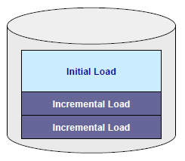
Differences from Operational Systems (Contd.)
Operational Systems
Data Warehouse
Load/
Update
Constant Change
Consistent Points in Time
• Updated constantly
• Data changes according
by need, not as a fixed
schedule.
• Added regularly, but loaded data
are rarely changed directly.
• Does not mean the data
warehouse is never updated or
never changes!!

Slide 10
Data in Data Warehouse
Characteristics of the data in a Data Warehouse:
• Separate DSS data base
• Storage of data only, no data is created
• Integrated and scrubbed data
• Historical data
• Read-only (no recasting of history)
• Various levels of summarization
• Meta data
• Subject oriented
• Easily accessible

Slide 11
Features of Data Warehouse
• Strategic enterprise level decision support
• Multi-dimensional view on the enterprise data
• Caters to the entire spectrum of management
• Descriptive, standard business terms
• High degree of scalability
• High analytical capability
• Historical data only

Slide 12
Data Warehouse: Benefits to Business
• Understand business trends.
• Better forecasting decisions.
• Better products to market in timely manner.
• Analyze daily sales information and make quick
decisions.
• Solution for maintaining your company's competitive
edge.

Slide 13
Data Warehouse: Application Areas
Risk management
Financial analysis
Marketing programs
Profit trends
Procurement analysis
Inventory analysis
Statistical analysis
Claims analysis
Manufacturing optimization
Customer relationship management

Slide 14
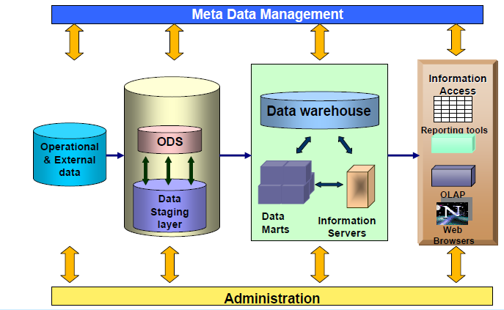
Data Warehouse Architecture

Slide 15
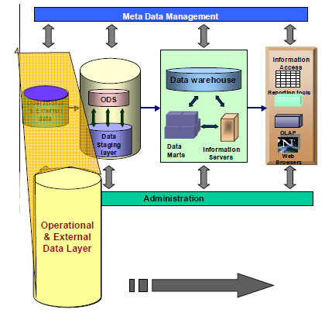
Operational and External Data Layer
The Database-of-record
Consists of system specific reference data and event data
Source of data for the data warehouse
Contains detailed data
Continually changes due to updates
Stores data upto the last transaction

Slide 16
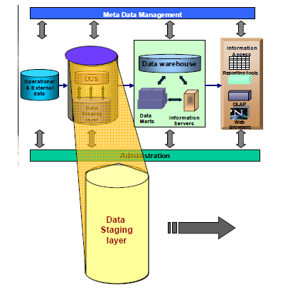
Data Staging Layer
Extracts data from operational and external databases
Transforms the data and loads into the Data Warehouse
This includes decoding production data and merging of records from multiple DBMS formats

Slide 17
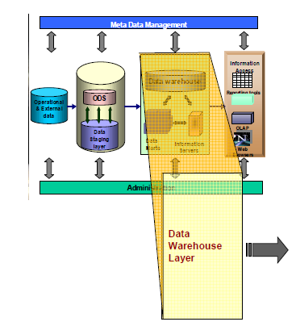
Data Warehouse Layer
Stores data used for informational analysis
Present summarized data to the end-user
for analysis
The nature of the operational data, the end-user requirements and the business objectives of the enterprise determine the structure

Slide 18
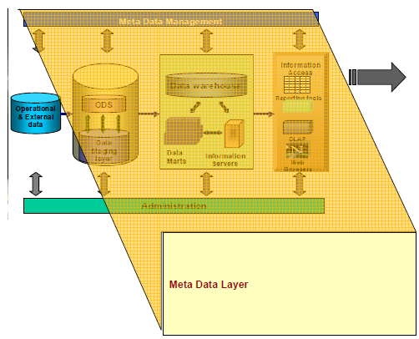
Meta Data Layer
Metadata is data
about data.
Stored in a repository.
Contains all corporate metadata resources: database catalogs and data dictionaries.

Slide 19
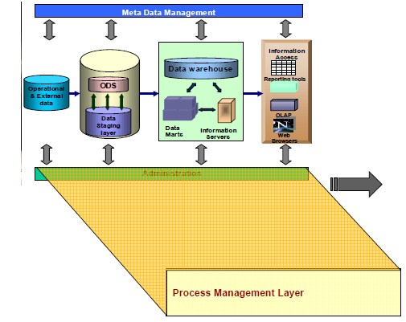
Process Management Layer
Scheduler or the
high-level job control
To build and maintain Data Warehouse and the data directory information.
To keep the Data Warehouse up to date.

Slide 20
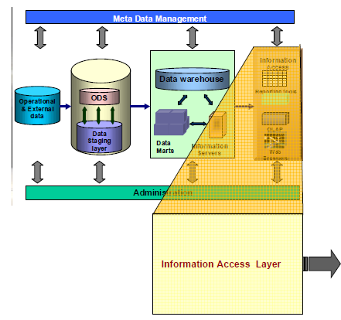
Information Access Layer
Interfaced with the Data Warehouse through an OLAP server.
Performs analytical operations and presents data for analysis.
End-users generate ad-hoc reports and perform multi dimensional analysis using OLAP tools.

